Slide 1
Introduction to Directed Acyclic Graphs
Causal Inference Shared Interest Group
January 19th, 2016

Slide 2
Overview/Goals
Provide introduction on the use of DAGs for confounder selection in nonexperimental studies
What DAGs offer; limitations
Overview of DAG terminology and rules
Overview of d-separation criteria for assessing open and closed paths
Share approaches for selecting minimum adjustment set
Share a few examples of DAGs and when/why other approaches to covariate selection may fail
Have a broad discussion on the use of DAGs; hope for this to be a conversation

Slide 3
Disclaimers/Focus
Most examples can be found in:
Modern Epidemiology 3rd edition (Chapter 12)
Williamson et al. (2014) Introduction to casual diagrams for confounder selection
Hernan et al. (2002) Causal knowledge as a prerequisite for confounding evaluation: an application to birth defects epidemiology
Will not be covering mathematical proofs supporting use of DAGs for causal inference or grounding in counterfactual definition of causation
Will focus on use of DAGs for confounder selection; many other uses (e.g. selection bias, instrumental variable selection, measurement error, mediation/moderation, etc. – see Ch. 12 Modern Epi)

Slide 4
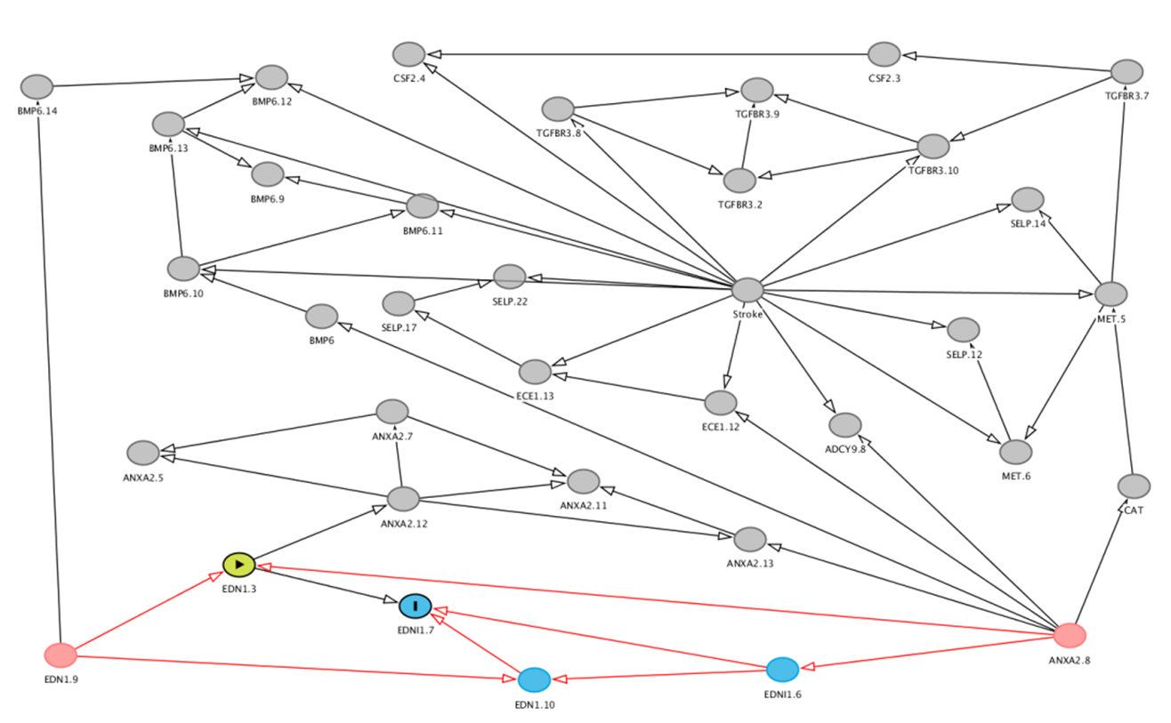
What is a DAG?

Slide 5
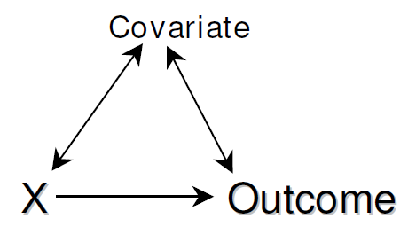
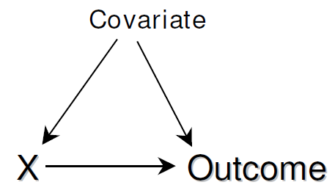
What is a DAG?
A casual diagram (e.g. graph) depicting the investigator's assumptions about casual relations among the exposure, outcome and covariates…that’s it!
Arrows are used to denote directionality
Contain only unidirectional arrows (single headed)
Must be acyclic; contain no feedback loops
Include all endogenous variables even if unknown (U)

Slide 6
Why DAGs?
Because we are often interested in estimating casual affects from observational data
Not an easy task as sample associations are directly observable, but causation is not
Four possible casual structures can contribute to an association between X and Y
1.) X may cause Y; what we are interested in
2.) Y may cause X; fairly easy to rule out
3.) X and Y may share a common cause we have failed to condition on; this is classical confounding
4.) we have conditioned on a collider (variable affected by X and Y)
*Associations may also be due to chance (i.e. sampling variability)

Slide 7
Why DAGs?
DAGs provide a powerful and intuitive tool for deducing the statistical associations implied in a hypothesized causal network (without requiring any mathematics)
Thus, they help us to select which variables we need to condition on (e.g. control for) to obtain unbiased estimates in nonexperimental studies
If our DAG is correct, and all important factors can be measured, we can identify the minimum adjustment set necessary to achieve “conditional exchangeability”
e.g. exposure is essentially randomized within levels of covariates
And causal inference can be made from the observed data

Slide 8
Why DAGs
Approaches to confounder selection based on statistical associations may fail to ID important confounders and support adjusting on non-confounders
Automatic variable selection; implicit assumption is that not all variables selected will be confounders, but all important confounders will be selected
Change-in-estimate criteria; implicit assumption is that any variable associated with a change is worth adjusting for
Traditional confounder definition – i.) associated w/ exposure in source population, ii) associated with outcome among the unexposed, and iii.) not on the casual pathway
Intermediate, collider, and instrumental variables can all behave statistically like confounders – need knowledge to guide selection!

Slide 9
Limitations of DAGs
How can we know the true underlying causal structure/network to draw the DAG?
Can’t be known; If knew we won’t need the study!
However, true casual structure exists even if we do not know it…
All casual inference based on statistical models are implicitly based on some casual structure
DAGs simply make these assumptions more explicit
Can compare competing casual models to assess their compatibility with the observed data
From the observed statistical associations can also deduce causal structures compatible with the observations/data

Slide 10
Limitations of DAGs
Drawing DAGs can be challenging as they need to be developed in the context of all available evidence
Often requires multidisciplinary input; and well developed theory/area
Latent variables can pose problems; causes and affects harder to deduce; can’t measure directly also harder to condition on
Effect modification “difficultish” to represent since each variable represented by a single node
Often represented by single node conceptually representing both variables; may necessitate multiple DAGs; current area of research
DAGs provide no information on the effect sizes or functional forms
Simply nonparametric graphical representations of casual networks

Slide 11
DAG Terminology
Variables are nodes
Arrows are edges and imply direction
Paths are unbroken sequences of arrows linking nodes regardless of direction
X > Y > Z
U > Y > Z
U > Y < X
X
Y
Z
U

Slide 12
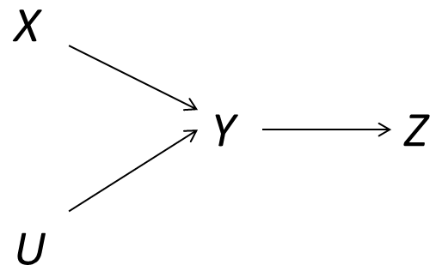
DAG Terminology
X is said to directly affect Y if there is an arrow from X to Y
X indirectly affects Z if there is a unidirectional path from X to Z (X>Y>Z)
Y is an “intermediate” variable between X and Z
Y is also said to “intercept” the path from (X > Y > Z) or from (U > Y > Z)

Slide 13
DAG Terminology
Children of X are variables directly affected by X; {Y}
Parents of Y are variables that directly affect Y; {X, U}
Descendants of X are all variables either directly or indirectly affected by X; {Y, Z}, but not U
Ancestors of Z are all variables that either directly or indirectly affect Z; {Y, X, U}

Slide 14
DAG Terminology
Directed paths are the special case where all edges in path flow head-to-tail (unidirectional); these are causal pathways
Ex. (X > Y), (X > Y > Z), (U > Y), (U > Y > Z)
All undirected paths are non-causal; (U > Y < X)
A variable on the path where two arrows meet is called a “collider”; child of both the variable before and after it

Slide 15
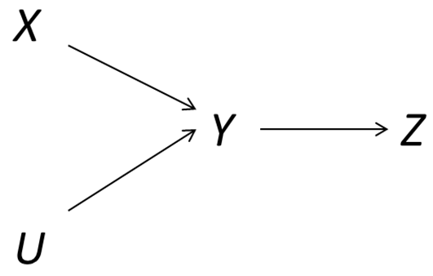
DAG Terminology
Nodes where multiple arrows meet are called “colliders”; node has multiple parents (U > Y < X)
Traditional terminology is that Y is a common effect of U and X; e.g. Y is child to both
Association is not transmitted across common effects!
Because two factors share a common effect doesn’t mean associated
No need to condition on collider; path is closed
Colliders cause special problems for causal inference

Slide 16
Collider bias
Conditioning on a collider results in collider bias because it opens a backdoor path across the colliding nodes
Basically, what happens is that two variables that were originally marginally independent become dependent conditional on Z
Thus, not only is adjustment not needed, but can be harmful
Let’s look at a hypothetical example…

Slide 17
Example Hernan 2002
X represents being on a diet
Y represents recent diagnosis of non-diet-related cancer
Z represent recent weight loss > 5kg (1=yes, 0=no)
Assume X does not cause Y; Z common cause of X and Y
X and Y are marginally independent in the source population
Table 1 below
RRXY = (100/(100+100)) / (200/(200+200)) = 1
Knowing that someone was dieting does not change prob. of cancer
 | Y=1 | Y=0
X=1 | 100 | 100
X=0 | 200 | 200

Slide 18
Example Hernan 2002
Now we condition on recent weight loss (e.g. collider)
Given that someone lost weight, it becomes more likely that she had cancer if is she was not dieting
Data here are made-up, but the above conditional association is intuitive
Thus, for those that lost weight, being on a diet and being recently diagnosed with cancer are inversely related
RRXY|C=1 = 0.79 RRXY|C=0 = 0.92
Z=1
 | D=1 | D=0
X=1 | 55 | 25
X=0 | 70 | 10
Z=0
 | D=1 | D=0
X=1 | 45 | 75
X=0 | 130 | 190

Slide 19
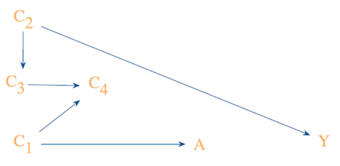
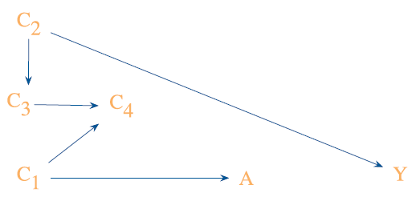
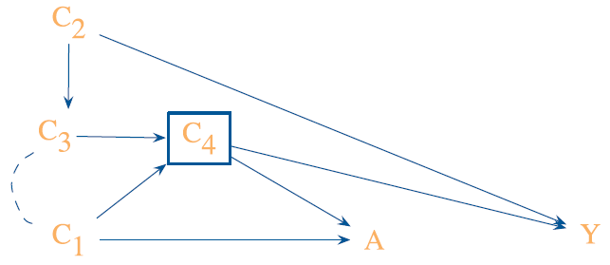
Examples of confounding and collider bias
Top: No effect of A on Y; no effect of A on Y observed; path blocked at collider C4; no bias
Middle: No effect of A on Y; potential association between A and Y observed; conditioning on collider C4; bias
Bottom: No effect A on Y; A < C4 > Y represents classical confounding, but adjustment opens up A < C1 > C4 < C3 < C2 > Y path; A Y association observed; bias (need also adjust C1)

Slide 20
d-separation criteria
Stands for “direction” separation criteria a.k.a. “directed graph separation rules”; this is one of the reasons we care about DAGs!
Two variables are d-connected if there is an open path between them; they are d-separated if all paths are closed
If two variables are d-separated then by definition they will be unassociated; no path from X to Y
If two variables are d-connected there is an open path implying a marginal association between them
Open directed pathways between X and Y are what we want to estimate!
We also want to control for all undirected open pathways between X and Y

Slide 21
d-separation criteria
Often defined in terms of unconditional and conditional separation
Unconditional d-separation
Path is open if there are no colliders on the path
If collider on path; closed unconditionally ; collider block path
Thus, all directed paths are open (as can have no collider)
Conditional d-separation
Conditioning on a non-collider Z, blocks the path at Z
Conditioning on a collider, or decedent of a collider, open the path
Combining these criteria allows us to identify the set of covariates that will block confounding paths!

Slide 22
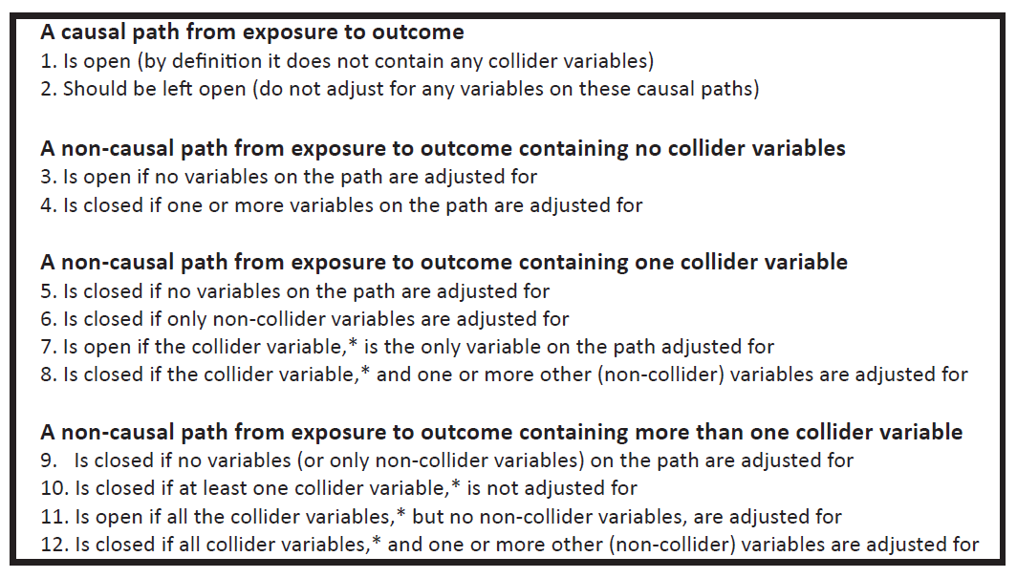
Williamson d-separation summary

Slide 23
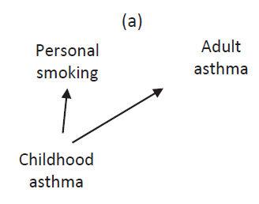
Let’s look at some examples
Interested in association b/w smoking and adult asthma
Here truth assumed to be known
Smoking is not a cause of asthma
Do we need to adjust for childhood asthma?
Smk < cAsthma > aAsthma is open
Estimate will be biased
Need to condition in cAsthma
Classic confounding bias

Slide 24
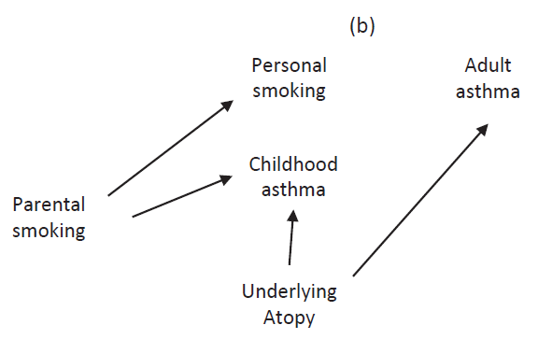
Let’s look at some examples
What if the true casual structure were different?
What do we condition on here?
Nothing – path blocked at collider parent smk > cAsthma < atopy; unbiased
If adjust for cAsthma here open up backdoor path; bias
Would have to also condition on parental smoking; unbiased
Minimum set = {parent smoking and cAsthma}

Slide 25
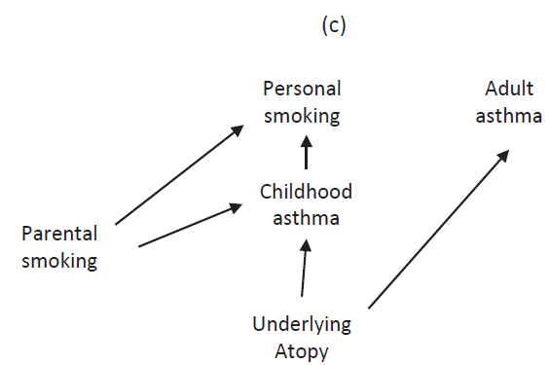
Let’s look at some examples
What of the casual structure were different?
What to condition on?
Path from personal smoking < cAsthma < atopy > aAsthma is now open; bias
Colliders are path specific!
Minimal sufficient adjustment sets
{atopy}
{cAsthma, parent smoking}

Slide 26
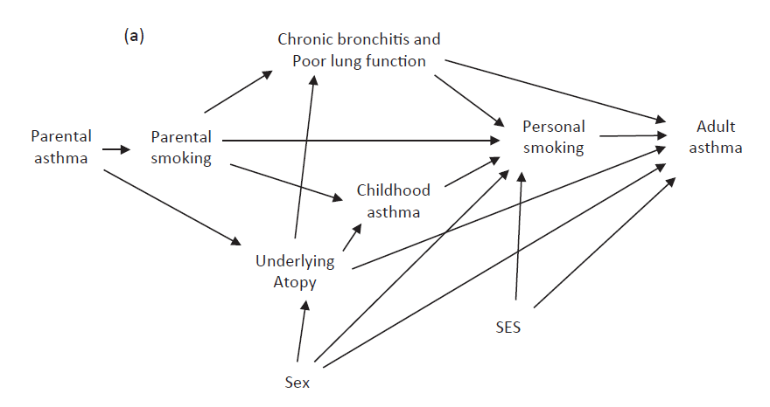
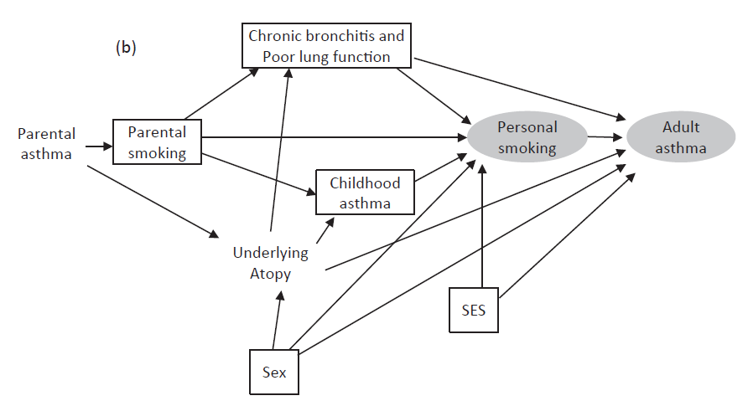
Bit more realistic example; still simple
- Might need some rules to figure out what to condition on here!

Slide 27
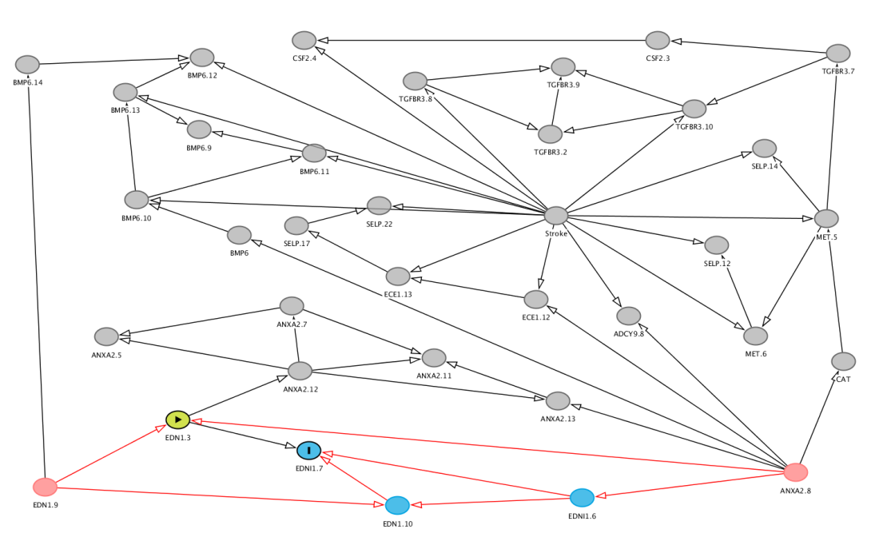
DAGs can get highly complex!
-Definitely going to need some rules here!

Slide 28
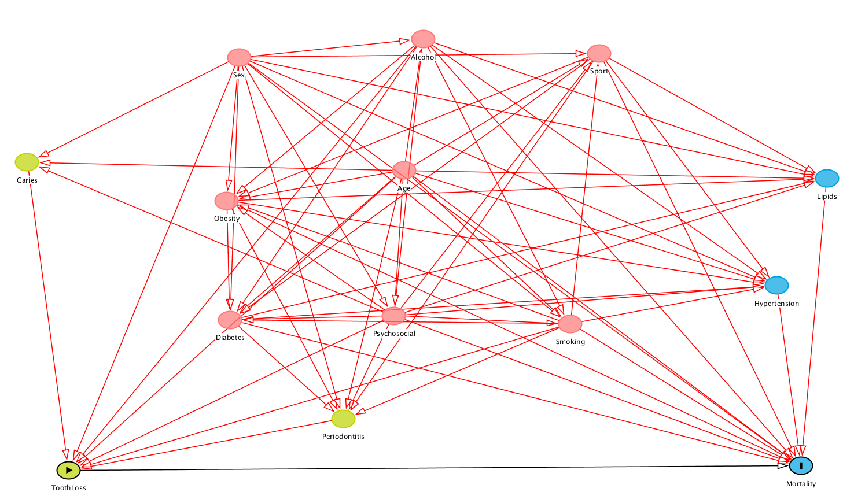
DAGs can get highly complex!
-And here!

Slide 29
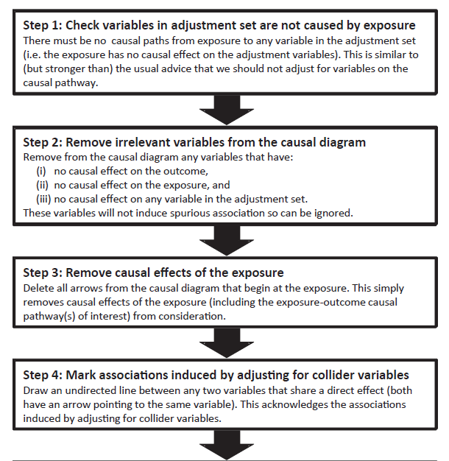
Pearl’s Rules to ID Minimal Adjustment Set

Slide 30
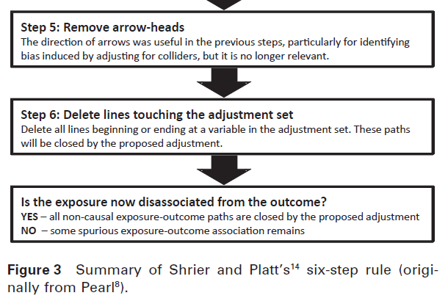
Pearl’s Rules to ID Minimal Adjustment Set

Slide 31
Pearl’s Rules to ID Minimal Adjustment Set
Rules provide a formulaic approach to identifying a minimal adjustment set
Still need to start by guessing at the set
Still likely to be a bit confusing at first
Lucky there are some terrific open-source software packages that will do this for us!
DAGitty: web platform – very easy to use
dagR package in R

Slide 32
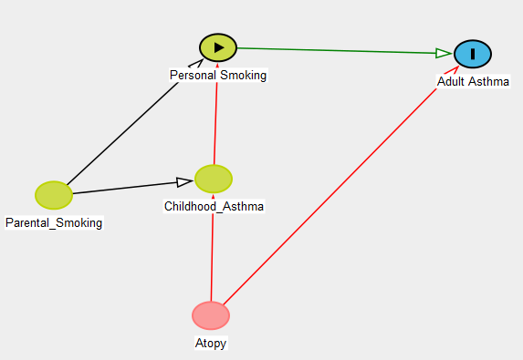
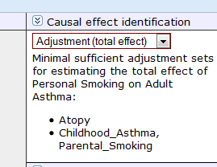
DAGitty Example
I made this example in about 60 sec.
Red shows biasing path

Slide 33
Example of when other approaches may fail
Example taken from Hernan et al. (2002) Causal Knowledge as a Prerequisite for Confounding Evaluation
Examined relation between folic acid supplementation and neural tube defects in the Slone Epidemiology Birth Defects Study (1992-1997 to rule out impact of fortification)
Cases were mothers who’s infants had neural tube defects; controls delivered infants with non-folic acid related defects
Exposure was folic acid supplementation (yes/no)
C is a potential confounder, unrevealed for now, but known to not be on the casual pathway from exposure to disease
For simplicity assume all variables measured w/o error

Slide 34
Example of when other approaches may fail
Automatic variable selection: add if p-value < 0.10; covariate meets this criteria
Change-in-estimate criteria: changes OR by ~15%; covariate meets criteria
Traditional confounding definition: meets all criteria
Unadjusted OR = 0.65 (0.45; 0.94); inversely related
Adjusted OR = 0.80 (0.53; 1.20) get some attenuation
What is the covariate? Whether pregnancy ends in still birth/therapeutic abortion
Do we think it is a confounder? Common cause of supplementation use and neutral tube defects? Not likely, but commonly adjusted for
Theory suggest loss of birth common cause of low folic acid; collider
Analogous to restricting subjects to just live births!

Slide 35
Good Resources
Introductory papers:
Williamson E, Aitken Z, Lawrie J, Dharmage S, Burgess J, Forbes A. Introduction to causal diagrams for confounder selection.Respirology. 2014;19(3):303–311.
Hernán MA, Hernández-Díaz S, Werler MM, Mitchell AA. Causal knowledge as a prerequisite for confounding evaluation: an application to birth defects epidemiology. Am J Epidemiol. 2002;155(2):176–84.
Shrier I, Platt R. Reducing bias through directed acyclic graphs. Bmc Med Res Methodol. 2008;8(1):70. doi:10.1186/1471-2288-8-70.
Chapter 12: Modern Epidemiology 3rd edition

